Slide 1
God Prospect 3 grammar simple past tense
Teacher: Maryam Ansari
Guilan

Slide 2
In this file we want to talk about simple past tense:
دوستان عزیزم دانش آموزان دوست داشتنی در این فایل میخواهیم باهم در مورد گذشته ی ساده یاد بگیریم:
در ابتدا به معرفی " گذشته ی ساده " در زبان انگلیسی و موارد کاربرد آن میپردازیم.
گذشته ی ساده چیست و در چه مواقعی از آن استفاده می کنیم.
خلاصه مطالب:
گذشته ی ساده در زبان انگلیسی برای بیان عملی که در گذشته انجام شده استفاده می‌شودو از تبدیل یا برگردان فعل ساده به زمان گذشته ساخته میشود. شکل گذشته ی افعال میتواند به دو صورت قاعده مند/باقاعده یا بی قاعده باشد که در اسلایدهای بعدی به تفصیل به آن می پردازیم.
به یاد داشته باشید که : گذشته ی ساده کاری است که یک یا چند بار در گذشته ی مشخص انجام و تمام شده است.مشخص بودن گذشته در زمان گذشته ی ساده بسیار مهم است.این "مشخص بودن زمان"را میتوان با قیود زمان و یا باجملاتی که در حکم قید زمان گذشته هستند و یا کلمه ای که در جمله نماینده ی یک گذشته ی مشخص باشد نشان داد.

Slide 3
به جملات زیر توجه کنید و به معانی آنها و قیود زمانی که در آنها به کار رفته دقت کنید:
Mary is a teacher now.
Mary was a student 2 years ago.
We want a glass of water every 1 hour.
We wanted a glass of water last night.
Mike & Sara go to school 5 days of a week.
They went to school yesterday.

Slide 4
Pay attention to the timeline:

Slide 5
When ; where & why do we use simple past tense? موارد استفاده از گذشته ی ساده:
Definition:
The past indefinite tense, also known as simple past tense, is used to indicate a finished or completed action/task that occurred/happened at a specific point in time in the past.
گذشته ی ساده کاری است که یک یا چند بار در گذشته ی مشخص انجام و تمام شده است.
مشخص بودن گذشته در زمان گذشته ی ساده بسیار مهم است.
این "مشخص بودن زمان"را میتوان با قیود زمان و یا باجملاتی که در حکم قید زمان گذشته هستند و یا کلمه ای که در جمله نماینده ی یک گذشته ی مشخص باشد نشان داد.
The past simple is used :
to talk about actions or processes that happened once or repeatedly in the past and that are completed (key words: ‘yesterday, last month, last year, two weeks ago, in 1999’ etc.):
“I bought a new car two months ago.”
“Sabrina arrived in London very late last night.”

Slide 6
Structure: نحوه ی ساخت جملات به زمان گذشته ی ساده:
Structure:
Subject + verb in the past form + . . . . . + adverb of time + . . . . . *** Regular verbs → infinitive (base form) + ending ‘-ed’ *** Irregular verbs → special forms according to the list at the end of book Examples: Alex went to Mexico last year. I ate a mango a few minutes ago. He had an exam yesterday.

Slide 7
کاربرد:
we use it to tell the stories because we want to talk about past.
we use it to show the actions that started and ended in the past.
we use it to share information about our past events – facts and habits in the past.
actions finished in the past (single or repeated)
I visited Berlin last week.
Andrew watched TV yesterday.
My friends went to Paris a week ago.
My parents ate a lot of junk food when they were young.
it can also be used for repeated action in the past; series of completed actions in the past
First I got up, then I had breakfast.
On Sunday my brother and I went to a nice lake. There we met our friends. We swam in the warm water and played volleyball in the afternoon. Too bad that we had to go home in the evening. We didn't want to go to school on Monday

Slide 8
کاربرد:
1.برای صحبت کردن درباره اتفاقی که یکبار در گذشته رخ داد.
* ما برای تعطیلات به اسپانیا رفتیم
We went to Spain for our holidays
2. برای صحبت کردن درباره اتفاق‌هایی که بارها و بارها در گذشته تکرار شده و تبدیل به روتین و روندی همیشگی شده بودند (اما دیگر نیستند).
وقتی در تعطیلات به سر می‌بردیم خیلی شنا می‌کردیم.
We swam a lot while we were on holiday
3. برای صحبت کردن درباره کاری که در گذشته به طور موقت در جریان بود.
* او وقتی جوان‌تر بود خیلی تنیس بازی می‌کرد.
She played a lot of tennis when she was younger.

Slide 9
خلاصه کاربردها:

Slide 10
Time markers: (key words in statements: ‘yesterday, last month, last year, two weeks ago, in 1999’ etc.):

Slide 11
What are the present & past tenses of to be verbs?

Slide 12
Past tense of to be verbs & its expressions:

Slide 13
صورت خبری / منفی / سوالی این دسته از افعال:

Slide 14
همانطور که پیش تر اشاره کردیم افعال به دو دسته ی قاعده مند/باقاعده و بی قاعده تقسیم میشوند:

Slide 15
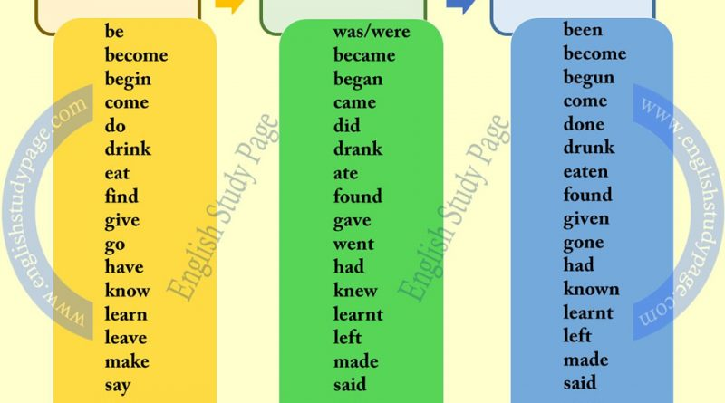
افعال بی قاعده
Irregular verbs
افعال قاعده مند/ با قاعده
Regular verbs

Slide 16
دلیل نام گذاری: چرا به یک دسته از افعال قاعده مند و به دسته ای دیگر بی قاعده می گوییم؟ بیشتر افعال انگلیسی با اضافه کردن ed- به انتهای شکل ساده به افعال گذشته تبدیل می‌شوند. این نوع افعال، افعال باقاعده محسوب می‌شوند. برخی افعال نیز بدون قاعده خاصی به صورت گذشته در می‌آیند، این افعال بی‌قاعده هستند و باید آنها را حفظ کرد.
Regular verbs:
a verb following the normal pattern of inflection.
"the general rule is that regular verbs form the past tense by adding -ed"
In English, the "usual" rule is to add -ed or -d to the base form of the verb to create the past forms.
افعالی که برای گذشته شدن از قاعده ی کلی پیروی می کنند.
قاعده کلی چیست؟
به انتهای فعل -edاتصال -dیا
Irregular verbs:
a verb that does not follow the normal pattern of inflection.
"there are some differences in irregular verbs between British and American English"
A verb in which the past tense is not formed by adding the usual -ed ending. Examples of irregular verbs are sing (past tense sang); feel (felt); and go (went).
افعالی که برای گذشته شدن از قاعده ی کلی مانند افعال باقاعده پیروی نمی کنند و دچار تغییر در ساختار درونی فعل از جمله تغییرات واکه ای در ساختمان فعل می شوند.

Slide 17
Spelling Rules for Creating the Past Forms of Regular Verbs:
Add "ed" to most verbs:
jump > jumped
paint > painted
If a verb of one syllable ends [consonant-vowel-consonant], double the final consonant and then add "ed":
chat > chatted
stop > stopped

Slide 18
If the verb ends [consonant + "y"], change the "y" to an "i" and add "ed"
:cry > cried
fry > fried
If the verb ends "e," just add "d":
thrive > thrived
guzzle > guzzled
If the final consonant is "w," "x," or "y," don't double it:
sew > sewed
fix > fixed
If the verb ends in to one of the vowels( a /e / i / o / u )+ Y ; we do not change the "y" to an "i" and just add "ed“:
:play > played
Stay > stayed

Slide 19
3 ways of pronouncing –ed :

Slide 20
Now try & repeat:

Slide 21
افعال بی قاعده:
*** Check the dictionary at the end of your book and try to memorize them***
***به افعال بی قاعده ی انتهای کتابتان نگاهی بیندازید و سعی کنید آنهارا حفظ کنید.***
مجدد اشاره می کنیم که:
این دسته از افعال برای گذشته شدن از قاعده ی کلی مانند افعال باقاعده پیروی نمی کنند و دچار تغییر در ساختار درونی فعل از جمله تغییرات واکه ای در ساختمان فعل می شوند.
مثلا:
Eat > ate
Run > ran
Buy > bought
*همانطور که مشاهده می کنید این دسته از افعال وقتی گذشته میشوند از هیچ قاعده ای پیروی نمی کنند و می بایست آنهارا حفظ کنید.

Slide 22
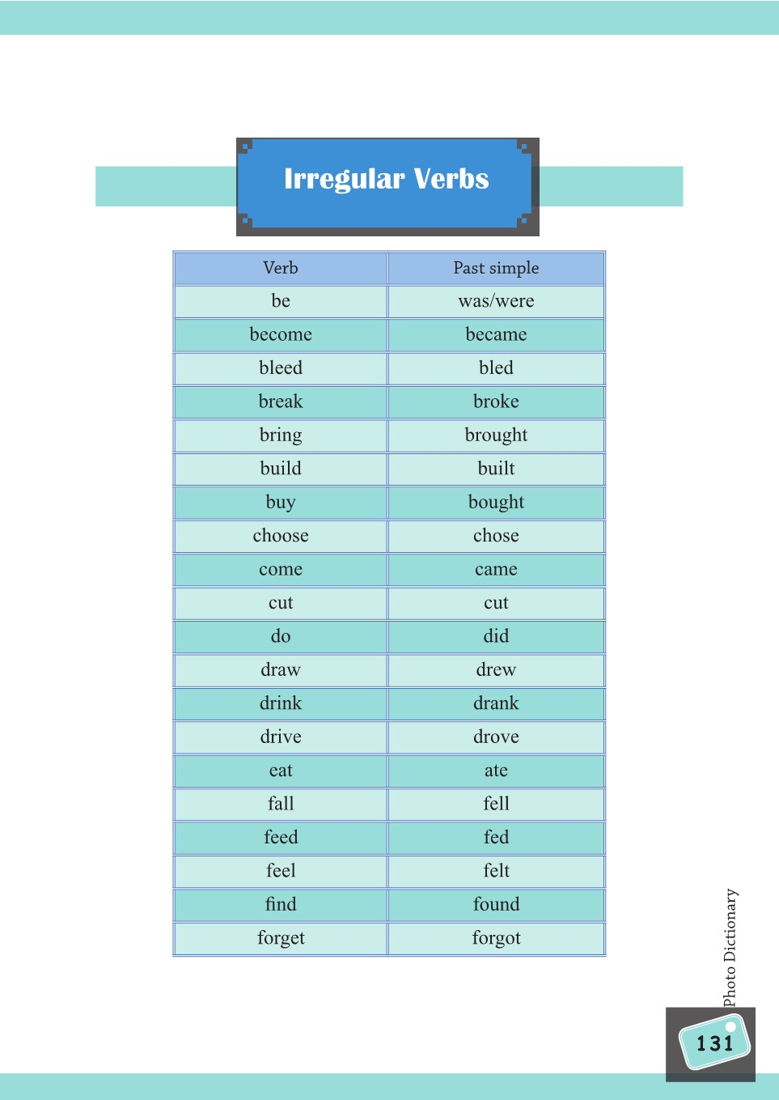

Slide 23
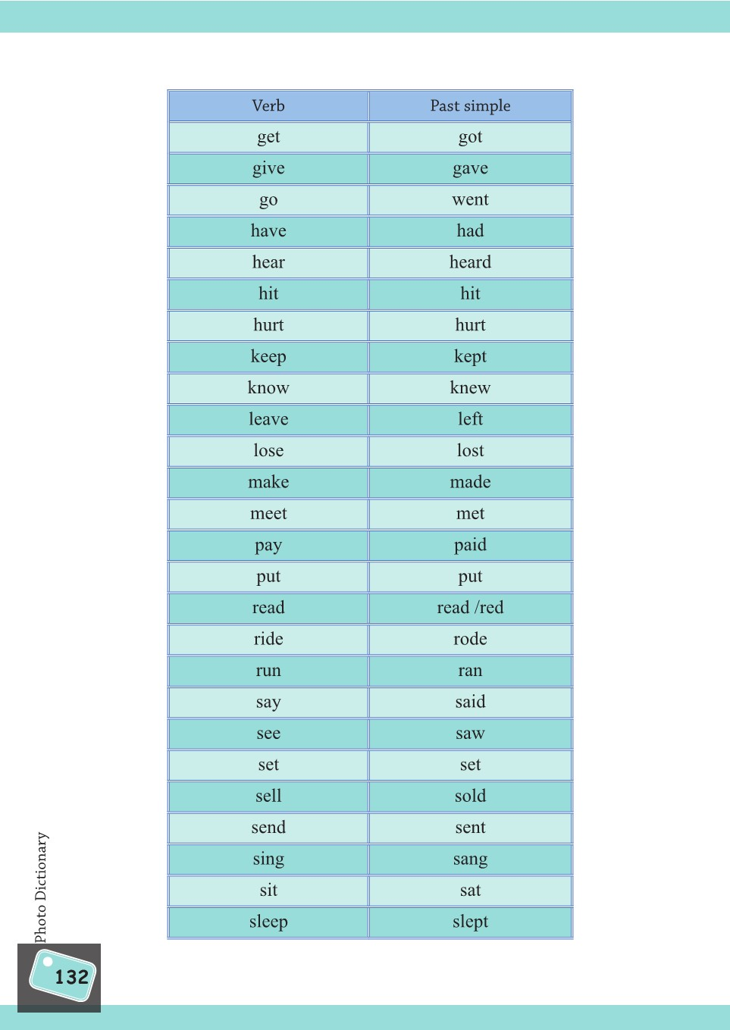

Slide 24
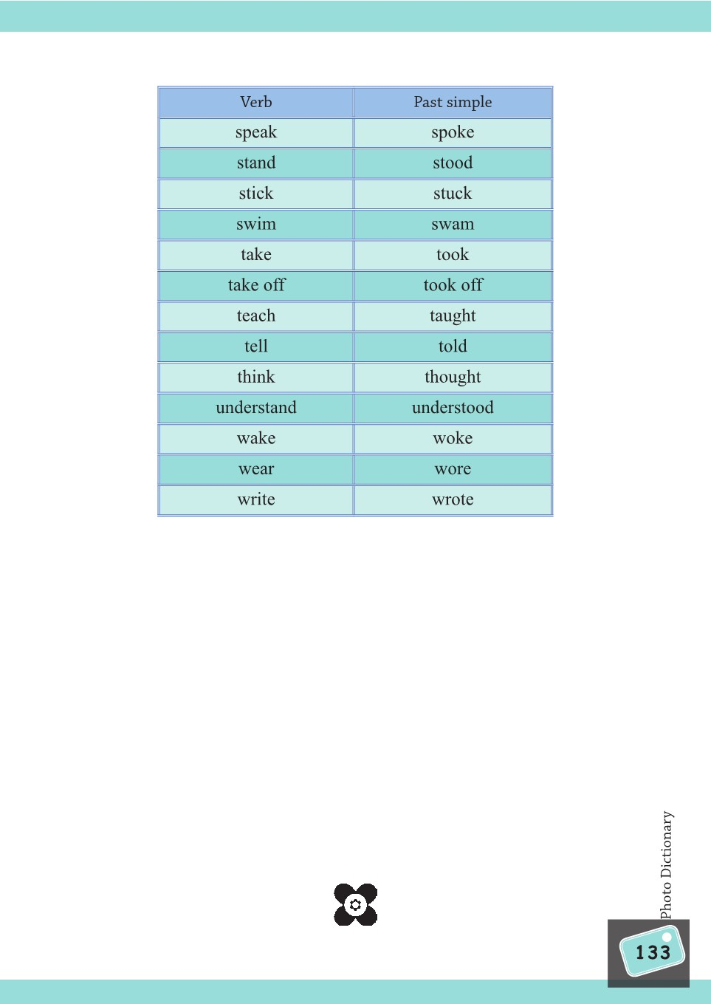

Slide 25
1. Forming a negative Negatives in the simple past are formed by adding didn't (informal) or did not (formal) before the simple form of the verb. The verb BE is an exception to this; in the caseof BE, we just add n't (informal) or not (formal) after "was" or "were":
Simple past statement | Informal negative | Formal negative
I had a car. | I didn't have a car. | I did not have a car.
You ate my toast. | You didn't eat my toast. | You did not eat my toast.
He was here yesterday. | He wasn't here yesterday. | He was not here yesterday.
They were in the park. | They weren't in the park. | They were not in the park.

Slide 26
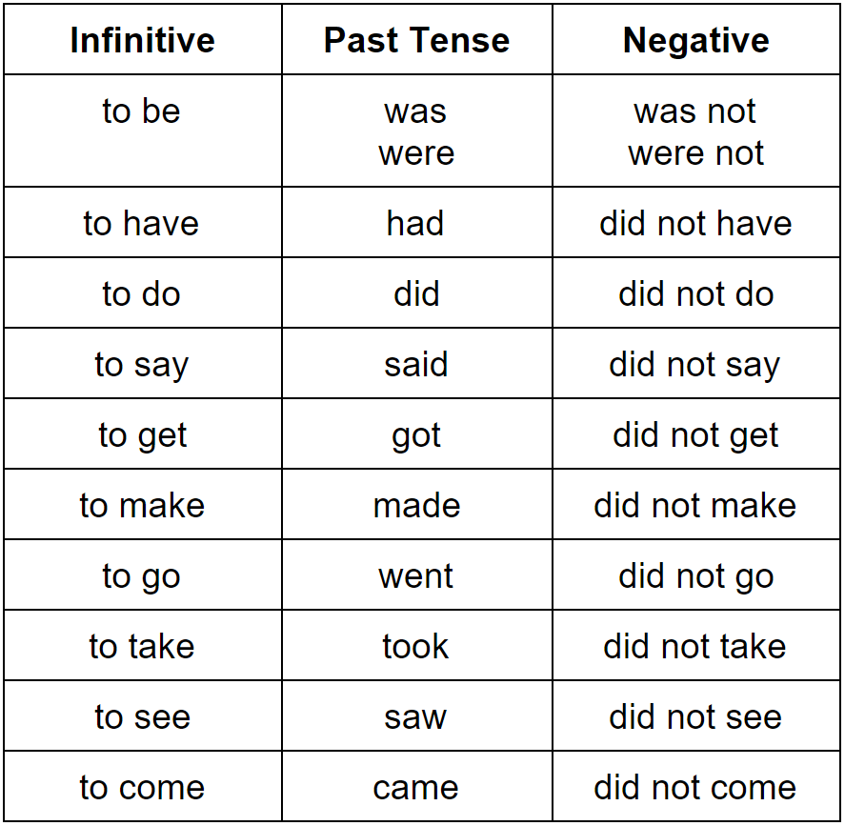

Slide 27
2. Forming a yes/no question Yes/no questions are also created using the auxiliary did. This time, the auxiliary is placed before the subject. The verb BE is an exception; in this case, we move BE before the subject. Here are the rules:
Simple past statement | Yes/no question
He brought his friend. | Did he bring his friend?
They had a party. | Did they have a party?
You were here. | Were you here?
She was sick. | Was she sick?

Slide 28
3. Forming a WH- question WH- questions (using words such as "what", "when", and "where") are also created by putting the auxiliary did before the subject (or moving BE, as explained above). Then, you add the WH- word at the beginning. Here are some examples:
Statement | Yes/no question | WH- question
The building fell down. | Did the building fall down? | Why did the building fall down?
They lived in Vancouver. | Did they live in Vancouver? | Where did they live?
The store was closed. | Was the store closed? | Why was the store closed?
They were wolves. | Were they wolves? | What were they?

Slide 29
Exercise: 1)try to fill in the blanks with appropriate form of verbs in simple past tense:
One day I ………(swim) out to a small island . When I……. (come) back to the beach I ……….(feel) tired so I went to sleep. Once, while I was half asleep I ………(think) I………… (hear) someone moving nearby but I………. (can't) see anyone. I ………….(wake) up an hour later and guess what? I couldn't find my clothes anywhere. Someone had stolen them! My watch was gone too, and my purse. But I had only ……….(bring) a few dollars for drinks and snacks so I didn't lose much. I………… (run) to the village, which fortunately was just up the road, and…………. (buy) a towel at a beach shop to dry myself. Then I ……….(go back) to my sister's house.
2)*** NOW ask & answer some questions in group.
3)***complete your home work.

Slide 30
Learn & enjoy
در پناه ایزد منان موفق و موید باشید
مریم انصاری
دبیر زبان انگلیسی – پایه نهم – استان گیلان

